Slide 1

Amity Institute of Information Technology
House Price Prediction using Machine Learning
Supervisor: By: Akshay Sharma
Dr. Vikas Thada Enrollment No.: A50500718003
Associate Professor Course: MCA V

Slide 2
CONTENTS
Introduction
Technology Used
Objective
What is Machine learning
Stages of predictive modelling
Hypothesis Generation
Data Extraction/ Collection
Data Exploration and Transformation
Predictive Modelling
Model Development / Implementation
Conclusion
Future Scope

Slide 3
Introduction
Problem faced during buying and selling the house.
Buyers and sellers don’t know the actual price of the house.
Many factors affects the price of the house.
No. of Bathroom
No. of rooms
Location
Square foot
Magic bricks and 99acres have this on their website
Our project is ML project based on certain specification of your home and it will guess the most price.

Slide 4
Technology Used
Python as programming Language.
Anaconda (Jupyter notebook)
Numpy
Pandas
Scikit-learn

Slide 5
Objective
Our objective is to build a Machine Learning model for Predicting House Price in Bangalore.

Slide 6
Machine Learning
Machine learning is an application of artificial intelligence (AI) that provides systems the ability to automatically learn and improve from experience without being explicitly programmed.
Types of Machine Learning
Supervised Learning
Classification
Regression
Unsupervised Learning
Dimensionality Reduction
Clustering
Reinforcement Learning

Slide 7
Stages of Predictive Modelling
Problem definition
Hypothesis Generation
Data Extraction/ Collection
Data Exploration and Transformation
Predictive Modelling
Model Development / Implementation

Slide 8
Hypothesis Generation
Sales Price should be increased with increase in area per Square feet.
The sales price would depend on the area where the house is located.
Higher the no. of Rooms and bathrooms more will be the price of house.

Slide 9
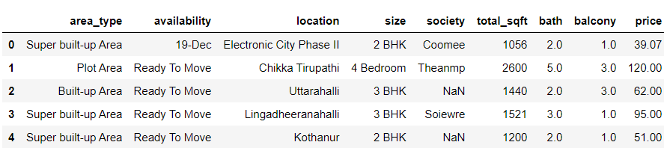
Data Extraction/ Collection
For this project we have taken the data from Kaggle (Bangalore house price prediction).
The Dataset contains 13320 rows and 9 columns.

Slide 10
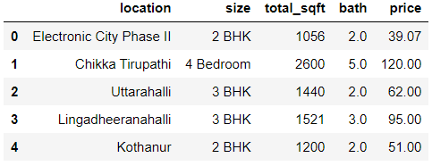
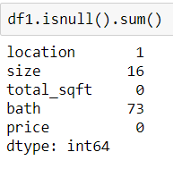
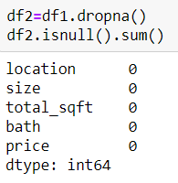
Data Exploration and Transformation
In the given data we are dropping area_type , society, balcony, availability considering that it will not affect the price of house.
Dropping Missing Values rows

Slide 11
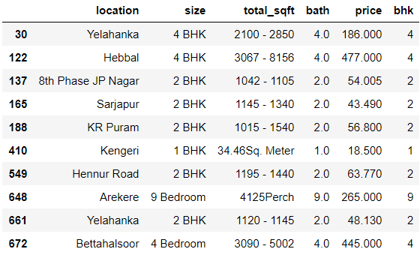
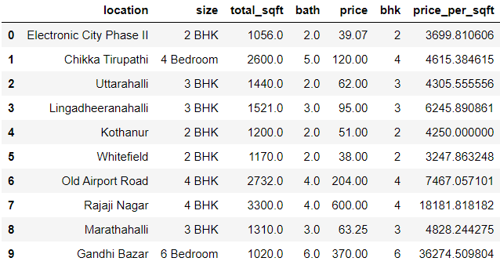
Cont.
Now we are left with 13246 rows and 5 columns.
Removing data that contains more than 20 Bathrooms.
Some square feet value are in range so we have taken mean.
Calculating price per square feet and creating new column.

Slide 12
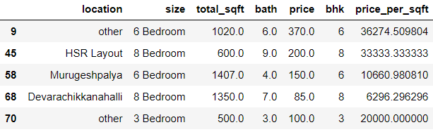
Cont.
In this data set we have high dimensionality data problem in location. We have 1052 location count less then 10 and 1293 with unique locations. Now labelling as “other” in place of location.
We found Outlier detection problem in given data as we consider less then 300 sqft we cant build 1BHK house so we have to drop that data from dataset.

Slide 13
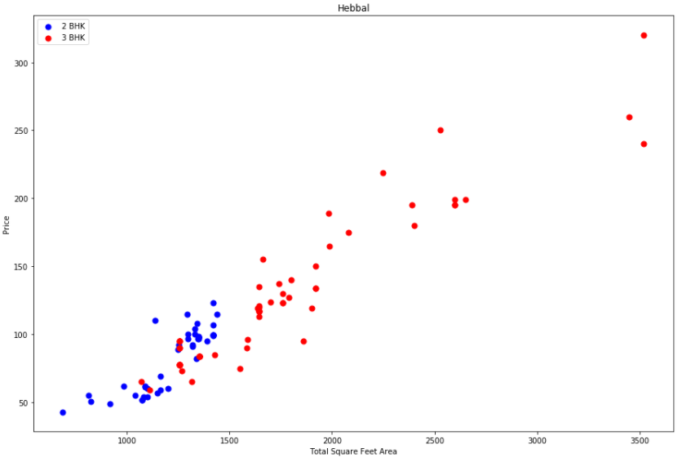
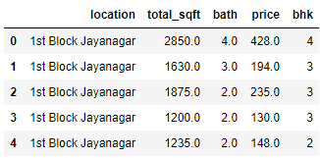
Cont.
Now we have to remove those 2bhk apartment whose price per sqft is less than Mean price per Sqft of 1BHk apartment as shown in scatter plot graph.
Now dropping size, price_per_sqft to get final data set.
Now we are left with 7251 rows and 5 columns.
Then we applied One Hot encoding (pandas dummies) in location. After thet we left with (7251,245).

Slide 14
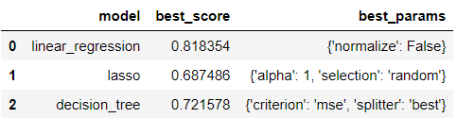
Predictive Modelling
In this step we divide our data set into 2 parts training and testing the dataset in 80:20 ratio.
In this project we have used 3 model [Linear Regression, Lasso and decision Tree]

Slide 15
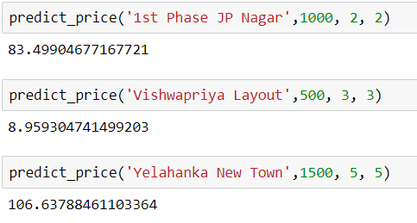
Results
We have taken 3 areas though which it calculate the price of house [Location, Square feet, Bathroom and BHK].
After entering the values it gives us values of house according to that in Lakhs.

Slide 16
Conclusion
The importance of this type of project is to help the buyers and sellers so that they can deal in the correct price.
These prediction models need to achieve high accuracy so the sample data is divided into 80% training data and 20% test data respectively.
We have achieved the 81% accuracy

Slide 17
Future Scope
There is a lot of variables affects house prices.
If data are available with a lot specification we can introduce more features, for example balcony, security, interior design, how old property and other details then we can more accurate result in this field.
We should try to apply different models for getting the more accuracy rate.
This application should be free for all from as reliable source.

Slide 18


